Slide 1
The Search For The Missing Battle Droid
Loz Mckenzie and Tristan Schuler

Slide 2
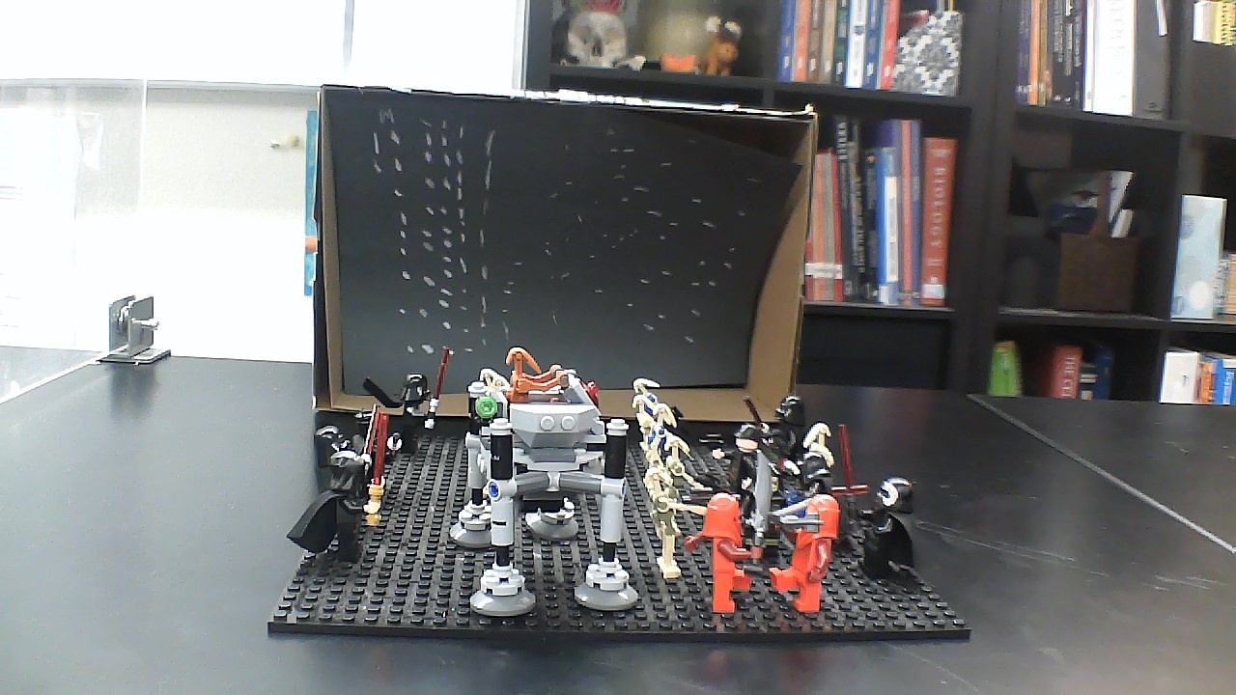

Slide 3
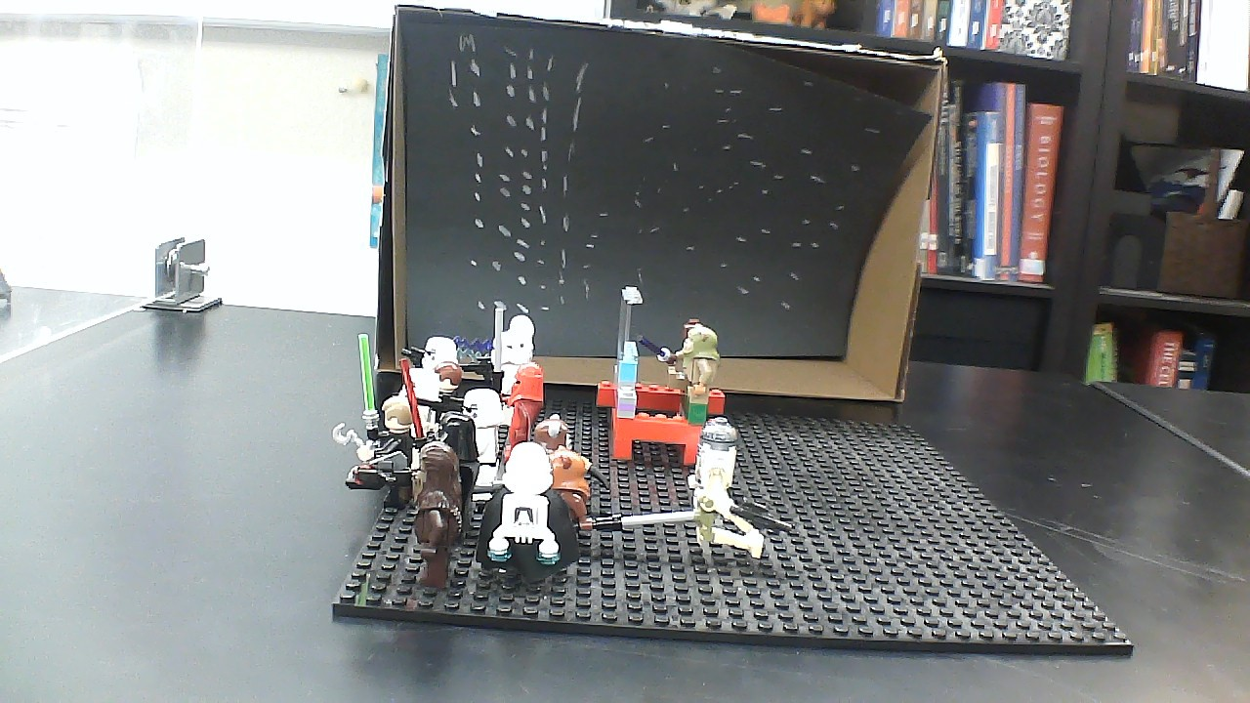

Slide 4
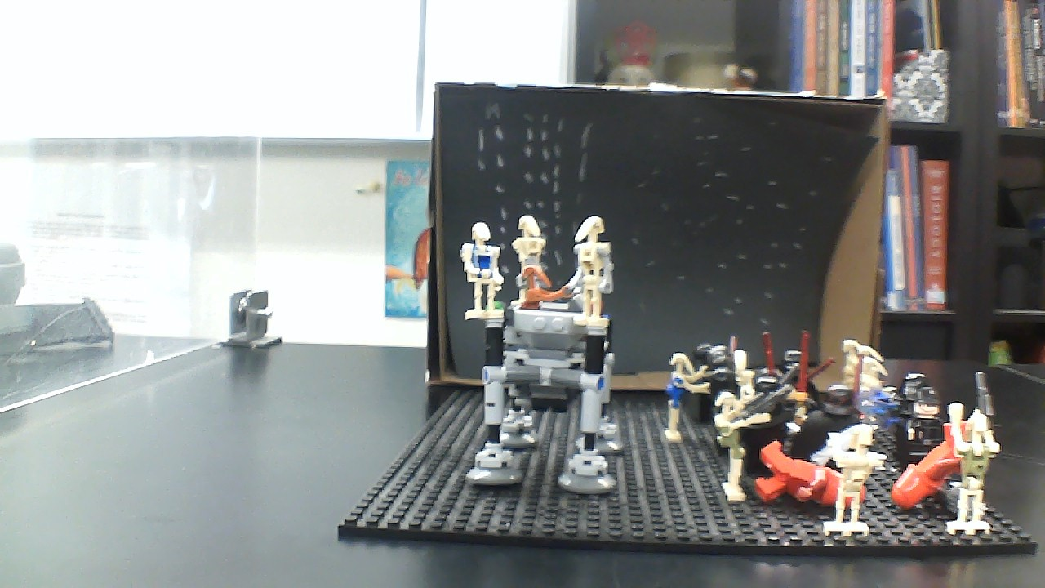

Slide 5
